Slide 1

NETFLIX DATA ANALYSIS
DATA-230 : DATA VISUALISATION

Slide 2
INTRODUCTION
Over 200 million subscribers make Netflix the world's largest streaming platform, revolutionizing the way we consume media. Its ability to provide personalized recommendations and exclusive content has been a key to its success.
The aim of this project is to explore Netflix's dataset and create a series of visualizations that highlight key insights.
There are over 8,000 titles in the dataset, along with their titles, release dates, and countries of production.
Additionally, each title credits list the directors, actors, and actresses who worked on it.

Slide 3
MOTIVATION
Netflix's massive user base presents analysts and researchers with a unique challenge due to the sheer volume of data generated, which stood as a challenging task that motivated us to choose this topic.
Using Data Visualization technology, by creating visual representations of the data, we can identify trends, patterns, and insights, which are often looked over.
In order to understand Netflix's success, we can use data visualization to learn about user behavior and content performance.
We hoped and were able to explore popular genres, audience retention rates, and the impact of original content through this project.

Slide 4
OBJECTIVE
A key objective of this project is to analyze the Netflix dataset and create an informative and visually appealing data visualization highlighting key insights into the platform's performance.
Analyzing Netflix user demographics, content preferences, and viewing habits allows us to build a comprehensive picture of the service.
We can communicate complex information in an accessible and intuitive format through data visualization, making it easier for stakeholders to understand and act on insights.
Ultimately, the objective is to provide valuable data-driven insights to content creators, marketers, and industry analysts.

Slide 5
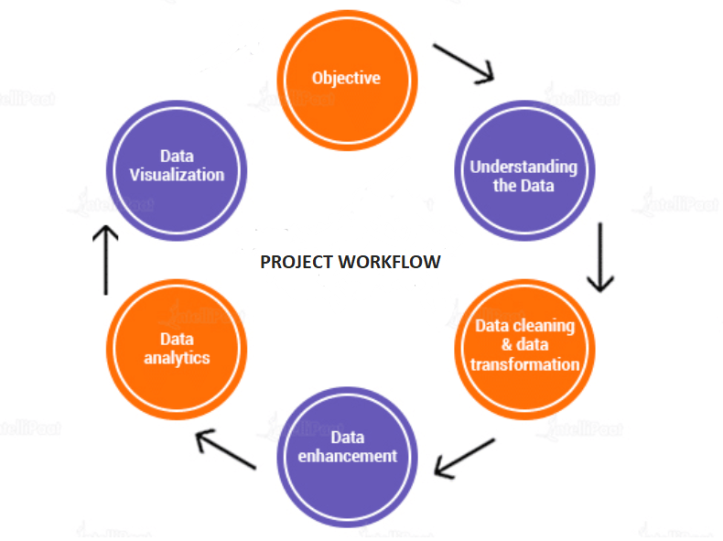
DATA MODEL / FLOW

Slide 6
DATASET DESCRIPTION
We happened to find the dataset over kaggle website.
The dataset contains the data collected from 2008 to 2001.
Listed in this dataset are the Netflix streaming service's movies and television shows.
There are specific columns such as title, director, cast, country of origin, year of release, rating, runtime, and genre (for example, action, drama, comedy), pertaining to a total of about 8000 rows.
The second dataset is also from kaggle website with 9000 rows and 29 columns and this dataset is similar to the first one.
This dataset contains specific columns such as title,genre,tags,series or movies,RunTime,directors,actors etc..,

Slide 7
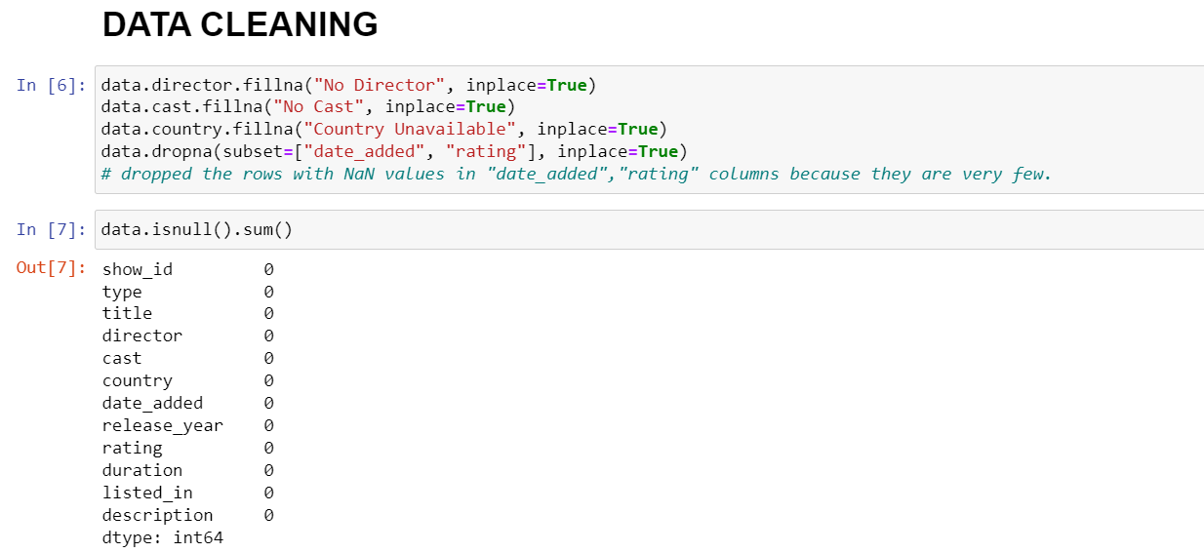
DATA CLEANING
We have cleaned the raw data by removing the null values in order to avoid any discrepancies with the final results.

Slide 8
DATA CLEANING
The second dataset is cleaned in the following ways:
Missing values are filled by using relative field for genre and tags columns and filled by using correlation matrix.
No duplicates in the dataset(Checked).
Handled wrong data types by converting to appropriate data types.
Dropped few columns which are not required and which has less rows than the average rows.
Multi-values in a single column handled by splitting and associated with the same row.

Slide 9
Problem Statement
By analyzing the data and coming up with insights, Netflix may decide what kinds of series and movies to make and how to expand their company in different regions.
What is the most producing genre?
Country wise content on Netflix ?
Average ratings in Netflix?
Top directors in terms of films and TV shows?
Does Netflix now place more of an emphasis on TV shows than on movies?
Ideal month to release movies.

Slide 10

EXPLORATORY DATA ANALYSIS & VISUALIZATIONS

Slide 11
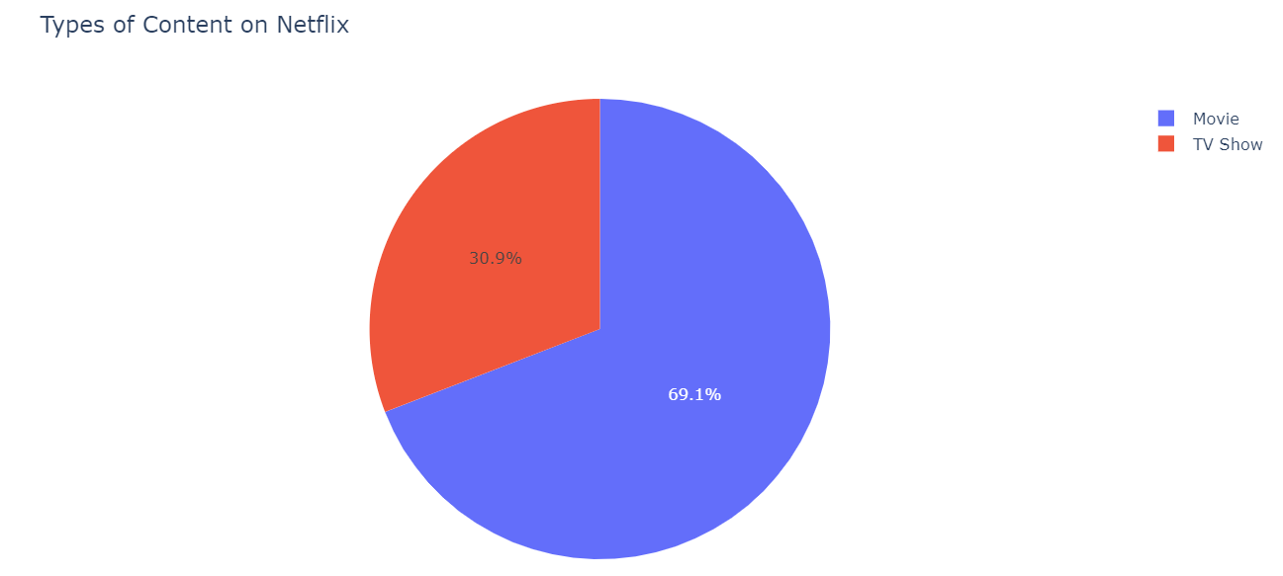
Overall, it is very evident that there are significantly more number of Movies than TV Shows. The reason could be the audience’s more inclination towards watching movies.

Slide 12
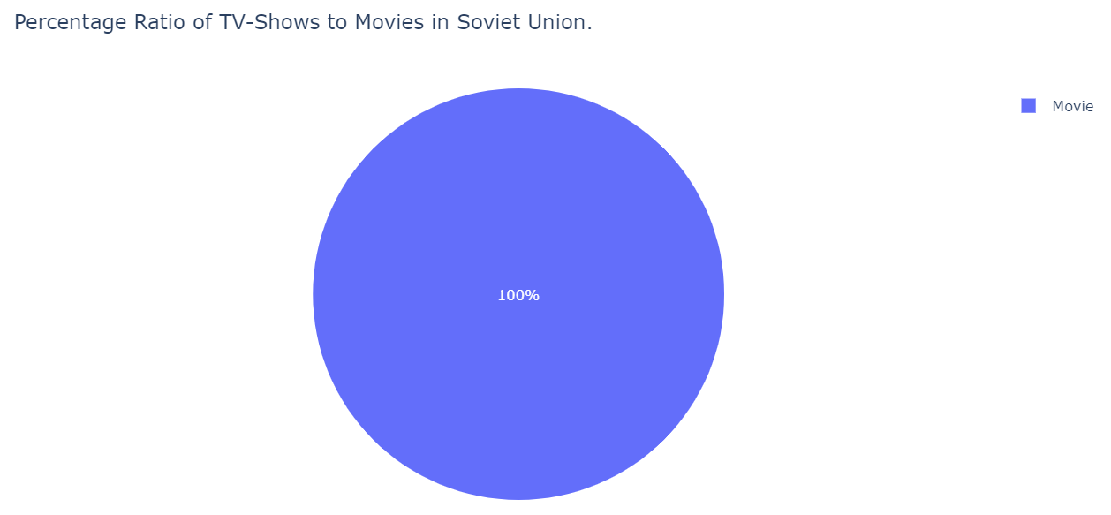
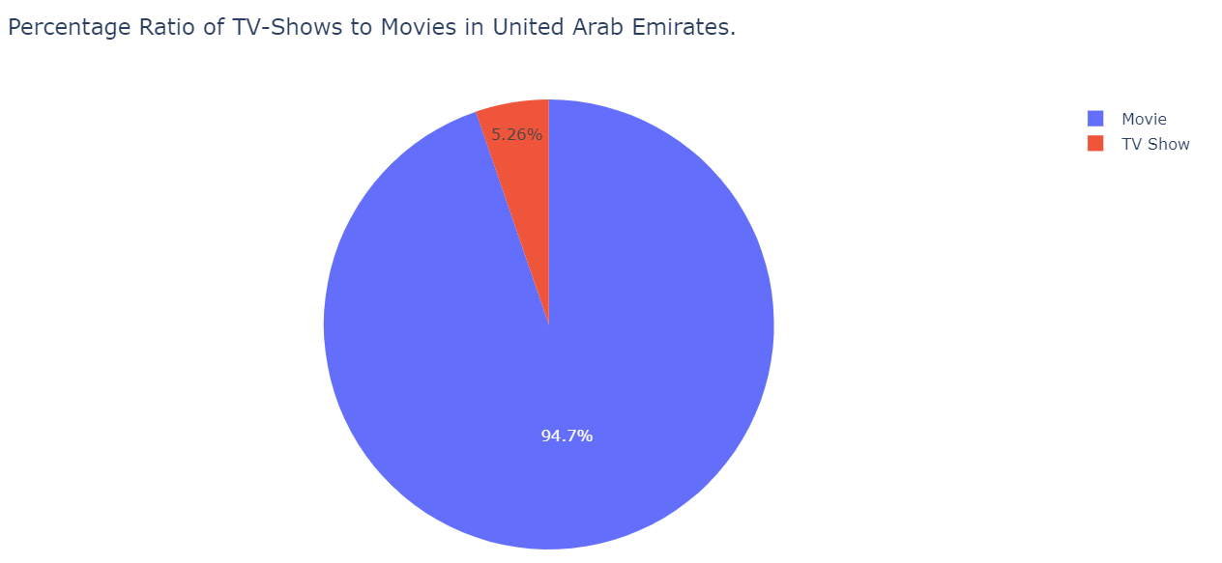
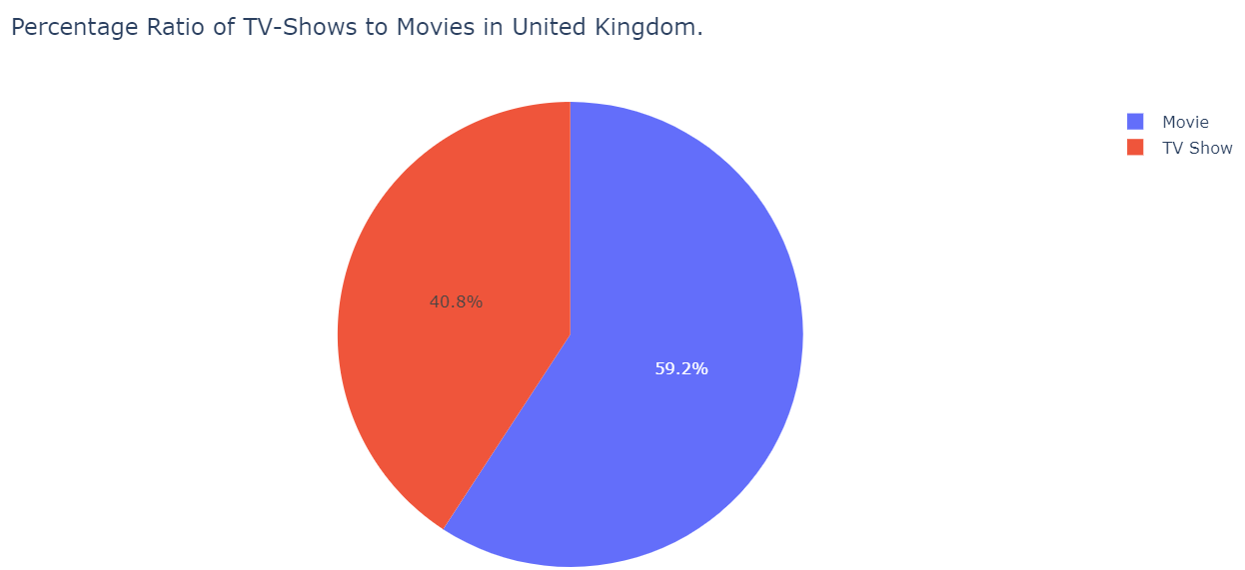
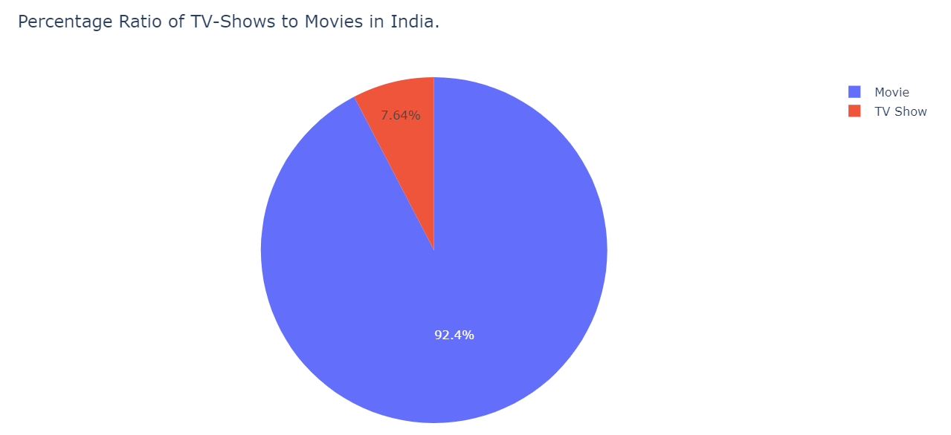

Slide 13
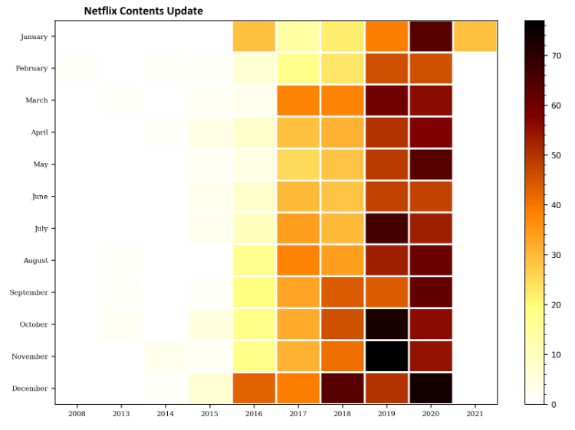

Slide 14
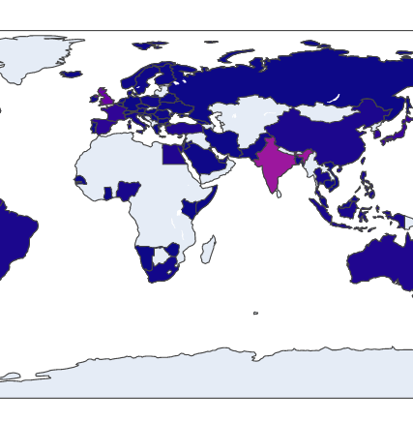
COUNTRY WISE CONTENT ON NETFLIX
Overall, America produces most of the content on netflix, while the Australian subcontinent does the least. This could be due to the scope and influence of the platform across the nations.

Slide 15
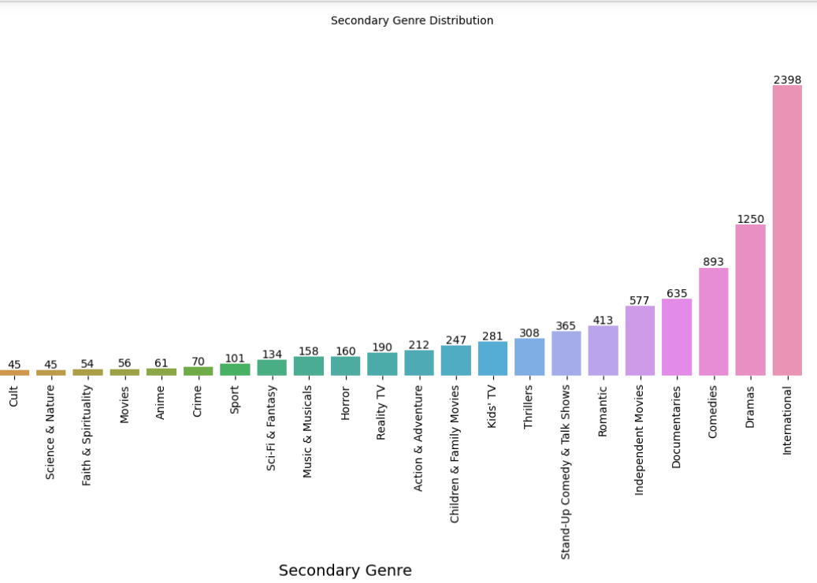
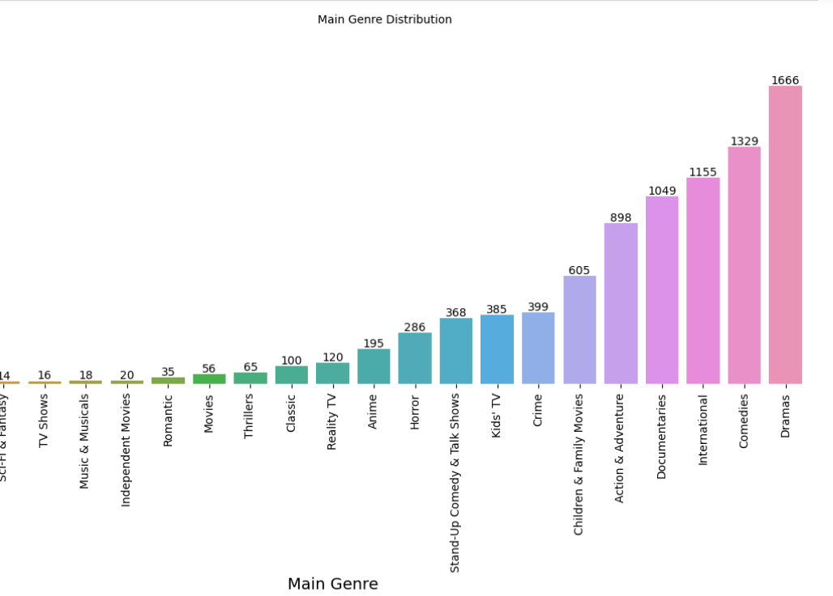
GENRE ANALYSIS
Drama genre has the highest number of distribution in main genre where as International genre has the highest in secondary genre category.

Slide 16
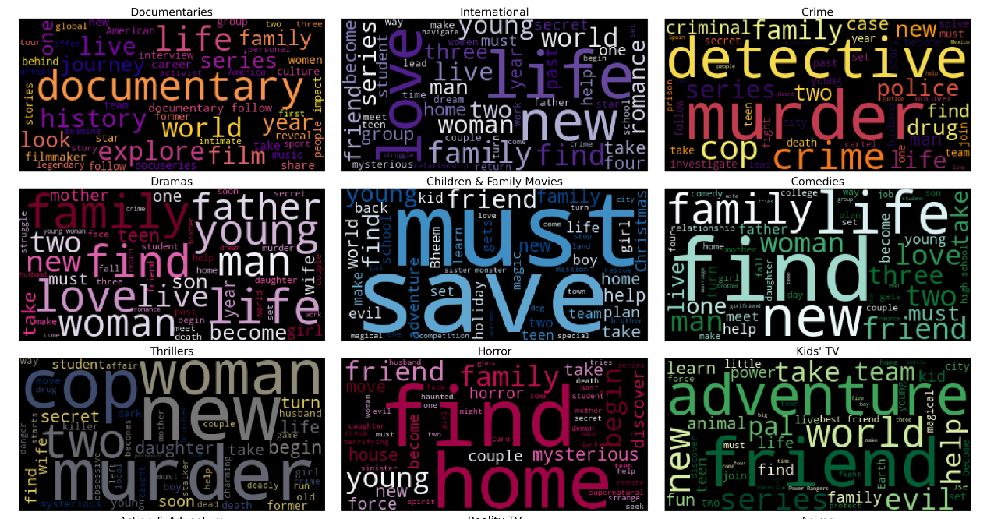

Slide 17
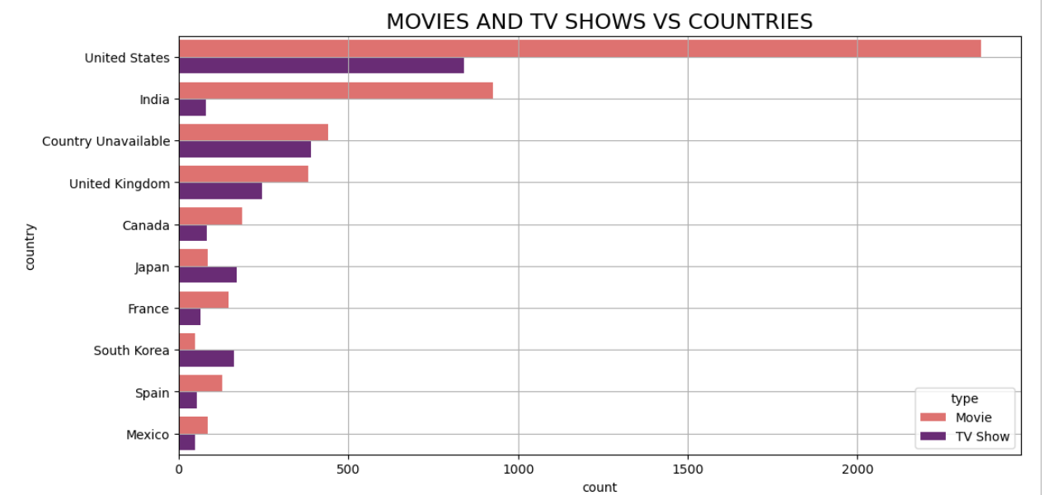
The graph depicts that the top 10 number of movies and tv shows in netflix around the world.
Japan and South Korea are the only countries which produces more Tv show compared to movies.
We can see that United states produces more content compared to any other country.

Slide 18
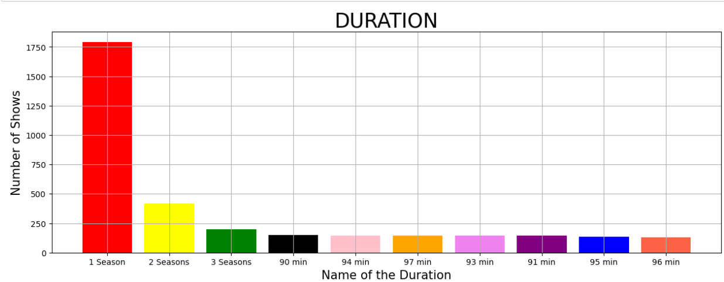

Slide 19
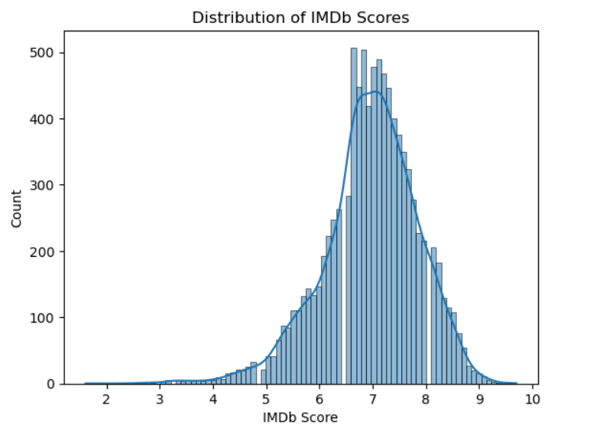
The plot visualize the distribution of IMDB ratings.
Most of the ratings are in between 6 to 8 which infers that netflix has good content.

Slide 20
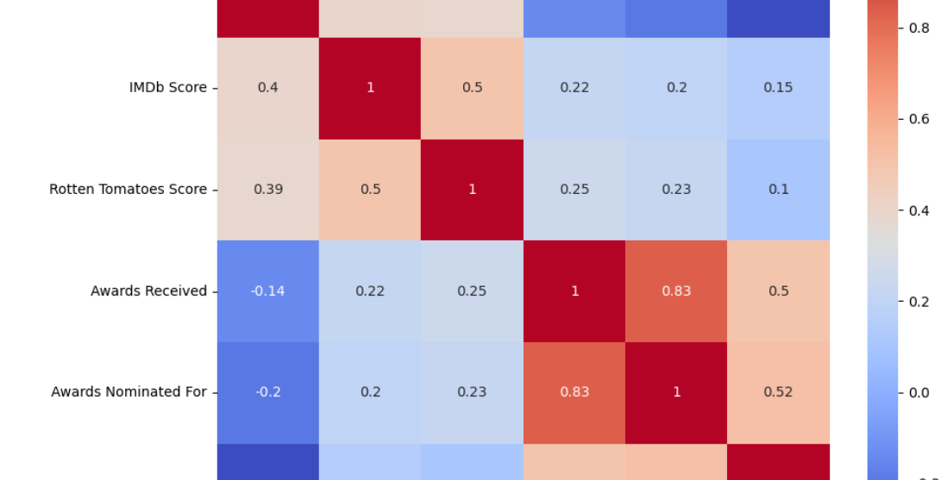

Slide 21
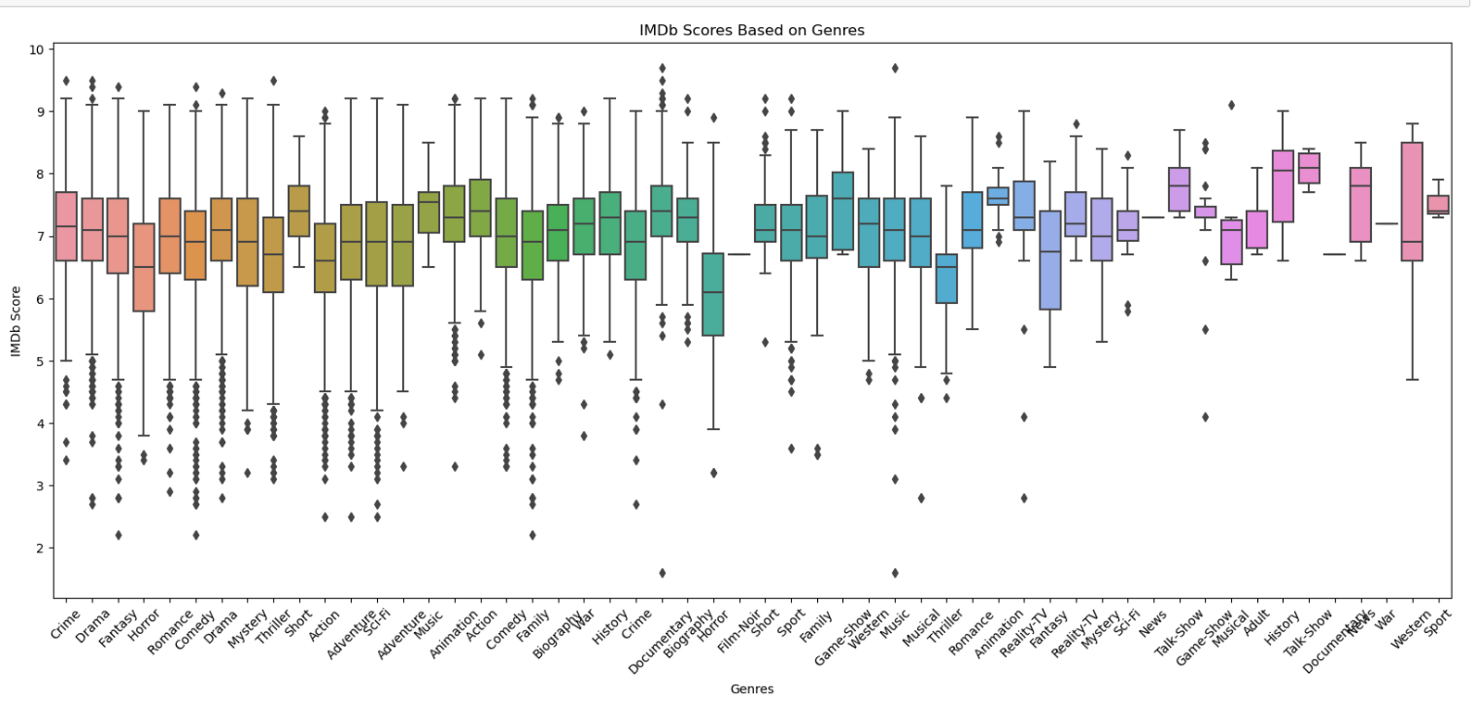

Slide 22
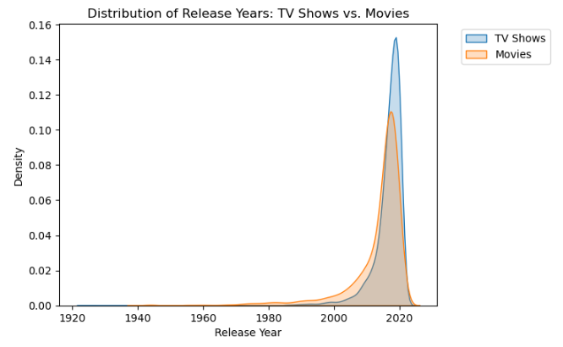
Plot's rightmost portion shows a higher density for both TV shows and movies, suggesting a larger quantity of recent releases on Netflix.
Over period of time, Netflix has focused on producing and releasing more TV shows compared to Movies.

Slide 23
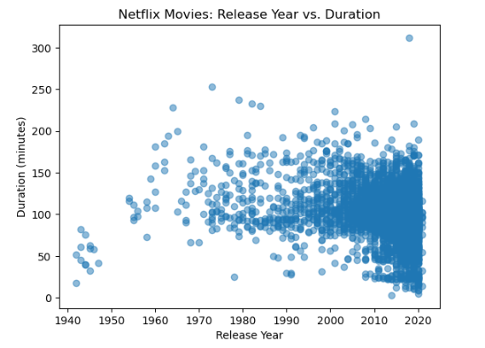
If we move towards more recent years, there appears to be a higher concentration of movies with shorter durations.
The majority of movies in the dataset have
durations ranging from 60 to 120 minutes.
This range seems to be the most common duration category across various release years.

Slide 24
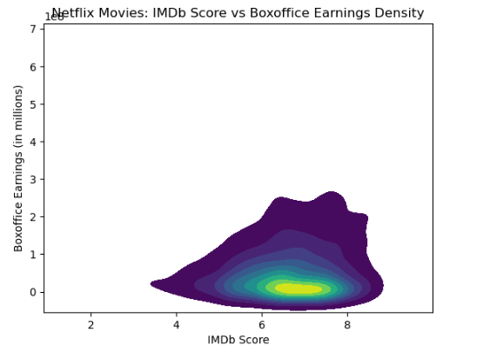
The density plot shows that the majority of Netflix movies have IMDb scores between 6 and 8, this indicates that Netflix tends
to offer movies with relatively high ratings.
This shows a positive correlation between IMDb scores and Boxoffice earnings indicating that movies with better ratings tend to
have higher box office performance.

Slide 25
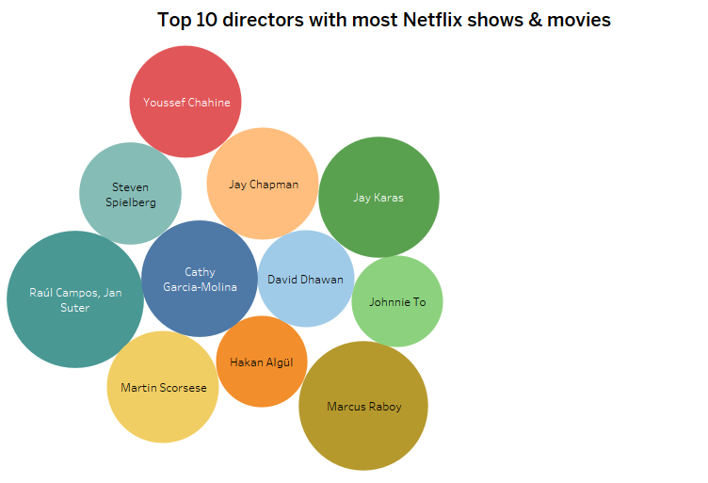
Bubble chart shows the top 10 directors who made most shows and movies on Netflix.
Various colors were used to show different directors.
Raul Campos and Jan Sutar are at the first place.

Slide 26
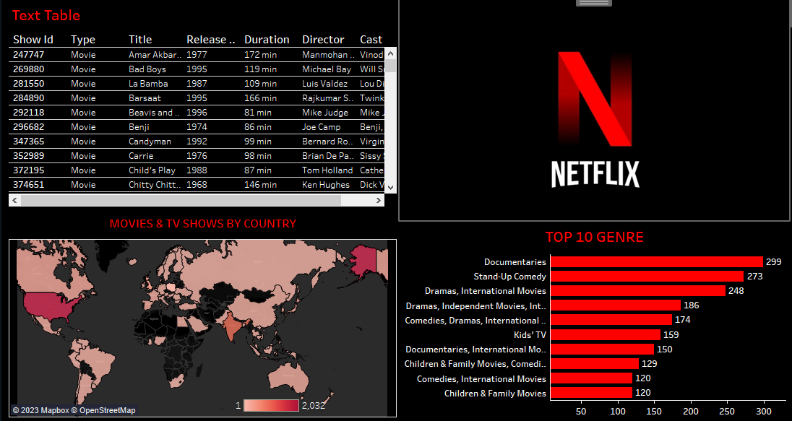

Slide 27
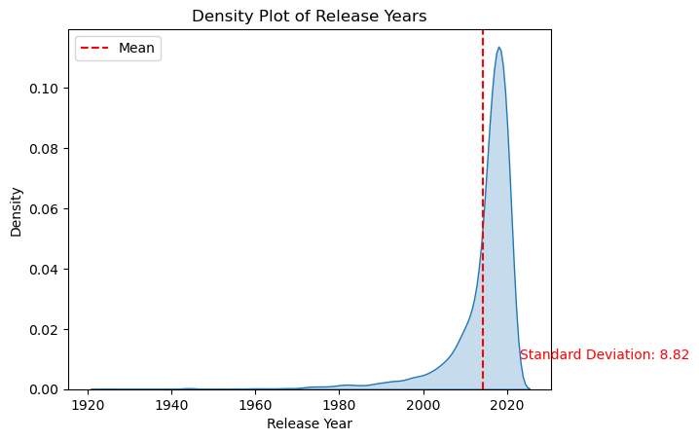
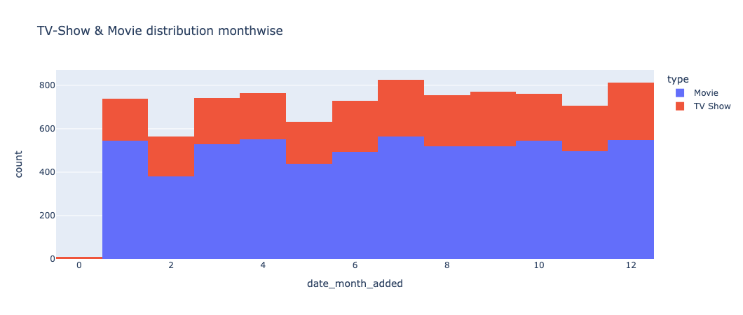
EDA Data Distribution : Left Skewed and Evenly Skewed
Our dataset is evenly distributed among all the months so, it won’t cause biased decisions when insights are explored.
The Leftmost graph shows the left skewed distribution based on the year, Basically, it is due to the fact that, netflix may not have the movies or TV-shows which are less popular from that time.
The Rightmost graph shows the even distribution of data TV-Show & Movie distribution monthwise.

Slide 28
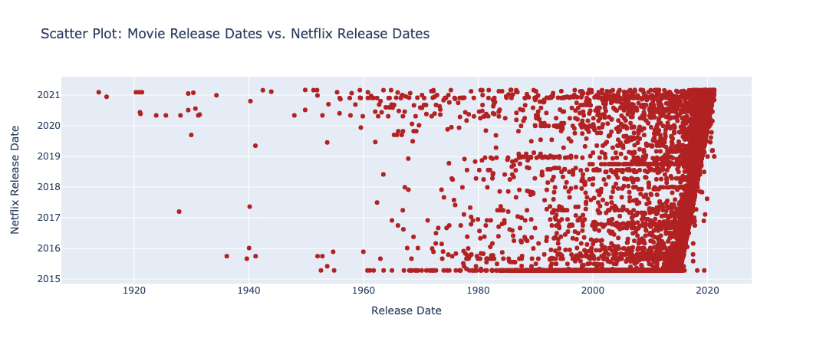
EDA: Associations among release dates & correlation
The graph provides the association between Movie release date vs Netflix release date, this helps us to find the trend between the actual release date and netflix release date. These days, the movies are releasing after 90 days and some movies are releasing directly in netflix and there are expected to be released within or next month.

Slide 29
CONCLUSION
After having performed the analysis of the chosen Netflix dataset, we happened to find quite many statistics over the platform which would further throw light on the areas and countries that have a room for improvement.
Also, we were able to figure out the taste in movies and Tv shows of various countries, that would imply to the platform, which aspects to focus more on.

Slide 30

FUTURE SCOPE FOR THE PROJECT
Implementing Machine learning techniques to generate movie/tv show recommendations.
Can extract upcoming live data through web scraping and generate additional insights.

